Slide 1

Testing fundamentals

Slide 2
Software Testing Fundamentals Overview of Software Testing Definition and importance of software testing in the SDLC Goals and principles of software testing Levels of Software Testing Introduction to Unit Testing, Integration Testing, System Testing, and Acceptance Testing Understanding the objectives, target, and environment of each level Software Testing Techniques Static vs. Dynamic Testing Techniques White-box, Black-box, and Grey-box Testing
Agenda

Slide 3
Types of Testing Functional Testing: Including regression, smoke, sanity, and user acceptance testing Non-Functional Testing: Including performance, load, stress, usability, and security testing Test Planning Creating test strategies and test plans Resource and environment planning Test Design Writing test cases and test scripts Designing tests based on requirements and specifications Test Execution Executing test cases and recording results Managing test cycles
Agenda

Slide 4
Defect Management Defect lifecycle management Reporting and tracking defects using tools
Agenda

Slide 5
What is Software testing
Software testing is the process of evaluating and verifying that a software product or application does what it is supposed to do. The benefits of testing include preventing bugs, reducing development costs and improving performance.
Verify and confirm that the prototype is free of bugs.
Examines the product to see if it conforms with the technical requirements as stated in the design and development.
Make sure the final product efficiently and effectively satisfies the client's needs.
Analyze the performance and usability of the product.

Slide 6
Why is Software testing needed ?
Nissan having to recall over 1 million cars due to a software defect in the airbag sensor detectors.
Software bug that caused the failure of a USD 1.2 billion military satellite launch.
Software failures in the US cost the economy USD 1.1 trillion in assets in 2016.
What’s more, they impacted 4.4 billion customers.

Slide 7
Why is Software testing needed ?
The “Why” seems simple.
People develop software. People make mistakes.
When we develop software, we make mistakes.
Those mistakes might be released to live.
The mistakes might manifest as Problems: defects, exploitable security issues, poor UX, performance issues

Slide 8
Types of Organizations
Product based
Service based
Product based - Organization that develop and produce products and provide services to clients
Examples – IBM , Microsoft, HP.
Service based - Organization that provide services to clients.
Examples – Capgemini , Mindtree , Infosys.

Slide 9






Types of Domains
Health care
Ecommerce
Educational
HR
Insurance
Banking
Pharmaceutical
Travel
Air line

Slide 10
Project and Team members
Team | Members
Project Management Team | Project Manager Project Coordinator
Business Team | Business Analyst / Business Systems Analyst
Architecture Team | Software Solutions Architect Systems Network Engineer Database Architect
Database Team | Database Developer
Development Team | Software Developer , Dev lead / Dev manager
Testing Team | QA Tester , QA Lead, QA Manager. Automation Tester/Manual tester/Performance/Security tester
Support Team | Technical Analyst Systems Analyst Database Administrator (DBA)

Slide 11
Goals and Testing principles
Testing shows presence of defects
Exhaustive testing is not possible
Early testing
Defect clustering
Pesticide paradox
Testing is context dependent
Absence of errors fallacy

Slide 12
Testing principles
Testing shows presence of defects
Testing talks about the presence of defects and don’t talk about the absence of defects. i.e. Software Testing reduces the probability of undiscovered defects remaining in the software but even if no defects are found, it is not a proof of correctness.
But what if, you work extra hard, taking all precautions & make your software product 99% bug-free. And the software does not meet the needs & requirements of the clients.

Slide 13
Testing principles
Exhaustive testing is not possible
Exhaustive testing is not possible.
Instead, we need the optimal amount of testing based on the risk assessment of the application.
Testers can't test everything, i.e., every combination of preconditions and inputs

Slide 14
Testing principles
Early testing
Testing should start as early as possible in the Software Development Life Cycle. So that any defects in the requirements or design phase are captured in early stages.
It is much cheaper to fix a Defect in the early stages testing

Slide 15
Testing principles
Defect clustering
Defect Clustering which states that a small number of modules contain most of the defects detected.
This is the application of the Pareto Principle to software testing
approximately 80% of the problems are found in 20% of the
modules.
By experience, identify such risky modules

Slide 16
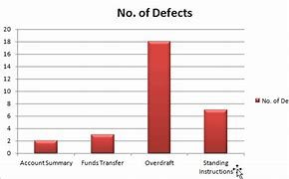
Testing principles
Defect clustering

Slide 17
Testing principles
Pesticide paradox
This principle defined that if we are executing the same set of test cases again and again over a particular time, then these kinds of the test will not be able to find the new bugs in the software or the application.
To get over these pesticide paradoxes, it is very significant to review all the test cases frequently.
And the new and different tests are necessary to be written for the implementation of multiple parts of the application or the software, which helps us to find more bugs.

Slide 18
Testing principles
Testing is context dependent
Testing is a context-dependent principle states that we have multiple fields such as e-commerce websites, commercial websites, and so on are available in the market.
There is a definite way to test the commercial site as well as the e-commerce websites because every application has its own needs, features, and functionality.
To check this type of application, we will take the help of various kinds of testing, different technique, approaches, and multiple methods.
Therefore, the testing depends on the context of the application.

Slide 19
Testing principles
Absence of errors fallacy
Once the application is completely tested and there are no bugs identified before the release, so we can say that the application is 99 percent bug-free.
But there is the chance when the application is tested beside the incorrect requirements, identified the flaws, and fixed them on a given period would not help as testing is done on the wrong specification, which does not apply to the client's requirements.
The absence of error fallacy means identifying and fixing the bugs would not help if the application is impractical and not able to accomplish the client's requirements and needs

Slide 20
Understanding Environments
PROD Environment
DEV1
QA1
QA1
STAGING / UAT / SME

Slide 21
Levels of testing
The four main levels of software testing are:
Unit testing
Integration testing
System testing
Acceptance testing

Slide 22
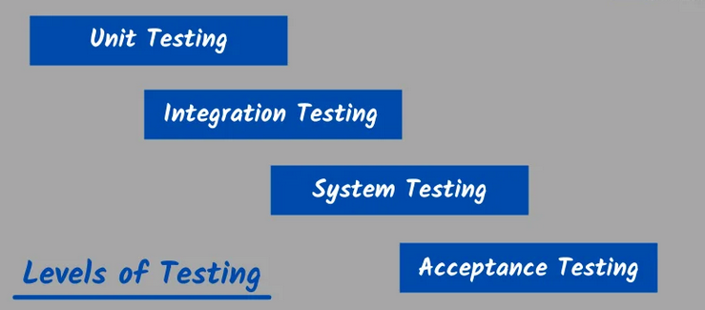
Levels of testing

Slide 23
Levels of testing
Unit Testing
Purpose: Verifies the functionality of individual components or modules of the software, such as functions, classes, or methods.
Performed By: Developers
Tools: JUnit, NUnit, pytest
Key Points:
Focuses on small, isolated parts of the system.
Ensures that each unit works as intended.
Uses mocks and stubs for dependencies.

Slide 24
Levels of testing
Integration Testing
Purpose: Tests the interaction between different modules or components to ensure they work together as expected.
Performed By: Developers or testers.
Approaches:
Top-Down: Start testing from the highest module to the lowest.
Bottom-Up: Start testing from the lowest module to the highest.
Big Bang: Test all modules together at once.
Incremental: Test modules in small groups progressively.
Tools: Postman, SOAP UI, JMeter, etc.
Key Points:
Identifies interface defects between components.
Verifies data flow and communication.

Slide 25
Levels of testing
System Testing
Purpose: Validates the complete and integrated system to ensure it meets specified requirements.
Performed By: QA testers.
Types:
Functional Testing.
API testing
Database testing
Non-functional Testing (Performance, Load, Stress, Usability, Security, etc.).
Tools: Selenium, LoadRunner, Appium, etc.
Key Points:
Tests end-to-end functionality.
Conducted in an environment similar to production.

Slide 26
Levels of testing
Acceptance Testing
Purpose: Determines if the system meets business requirements and is ready for deployment.
Performed By: End-users or clients.
Types:
User Acceptance Testing (UAT): Focuses on the end-user perspective.
Operational Acceptance Testing (OAT): Ensures operational readiness.
Tools: None typically; manual testing is common.
Key Points:
Final validation before release.
Helps ensure customer satisfaction.

Slide 27
Software testing techniques
Static Testing
Definition: A type of software testing where the code, design, and documentation are examined without executing the program.
Purpose: To identify defects early in the development lifecycle, before the software is run.
Techniques:
Reviews: Examining code, requirements, and documentation for errors.
Types: Peer Reviews, Walkthroughs, Inspections.
Static Analysis Tools: Automated tools analyze code for syntax errors, coding standards violations, and vulnerabilities.
Examples: SonarQube, Checkstyle, PMD.
Performed By: Developers, business analysts, or testers.
Benefits:
Early detection of defects.
Reduced cost of fixing bugs (since they’re caught before execution).
Improved code quality and adherence to standards.

Slide 28
Dynamic Testing
Definition: A type of testing where the software is executed to validate its functionality, performance, and behavior against requirements.
Purpose: To ensure the software behaves as expected when executed.
Types:
Functional Testing: Verifies that the software meets functional requirements.
Examples: Unit Testing, Integration Testing, System Testing.
Non-functional Testing: Assesses performance, scalability, and security.
Examples: Load Testing, Stress Testing, Security Testing.
Techniques:
Manual Testing: Human testers interact with the application.
Automated Testing: Tools execute pre-written test scripts.
Examples: Selenium, JUnit, Appium.
Performed By: QA testers or developers.
Benefits:
Validates actual system behavior.
Identifies runtime errors.
Tests user interactions and end-to-end workflows.

Slide 29
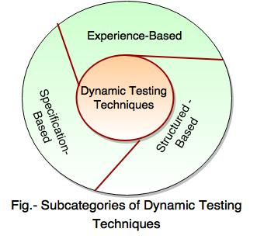
Dynamic Testing

Slide 30
Dynamic Testing Specification-Based Testing Technique
Specification-Based Testing Techniques (also known as Black-Box Testing Techniques) are a subset of Dynamic Testing used to verify that the software meets its functional specifications without requiring knowledge of its internal code or structure.
These techniques derive test cases based on the software's specifications, requirements, or user stories.

Slide 31
Dynamic Testing Specification-Based Testing Technique
Following are the types of specification Based testing techniques: i) Equivalence Partitioning
ii) Boundary Value Analysis
iii) Decision Tables
iv) State Transition
v) Use case testing

Slide 32
Equivalence Partitioning
Equivalence Partitioning (EP)
Purpose: Divides input data into equivalent partitions or classes that are expected to behave similarly.
Approach:
Identify valid and invalid partitions for input data.
Select one representative test case from each partition
Example: For an input field that accepts numbers from 1 to 100:
Valid partitions: [1-100].
Invalid partitions: [<1], [>100]
Benefits: Reduces the total number of test cases while maintaining coverage.

Slide 33
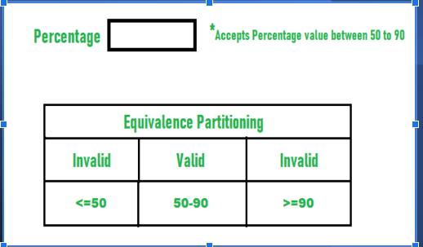
Equivalence Partitioning

Slide 34
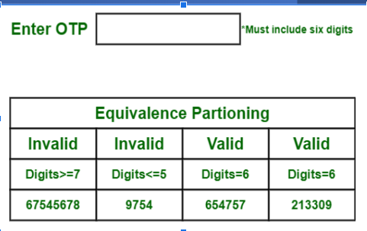
Equivalence Partitioning

Slide 35
Boundary Value Analysis
A boundary value for a valid partition is a valid boundary value.
A boundary value for an invalid partition is an invalid boundary value.
For each variable we check-
Minimum value.
Just above the minimum.
Nominal Value.
Just below Max value.
Max value.

Slide 36
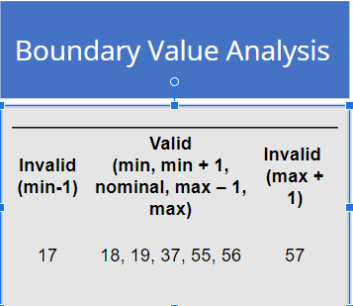
Boundary Value Analysis

Slide 37
Decision Tables
Purpose: Validates combinations of inputs and their corresponding system actions
using a decision table.
Approach:
Identify possible inputs (conditions) and their combinations.
Define the expected outputs (actions) for each combination.
Example: For a login system with inputs "Valid Username" and "Valid Password":
Conditions: {Valid/Invalid Username}, {Valid/Invalid Password}.
Outputs: Login Success, Login Failure.
Benefits: Helps ensure complete coverage of combinations,
particularly for complex business rules

Slide 38
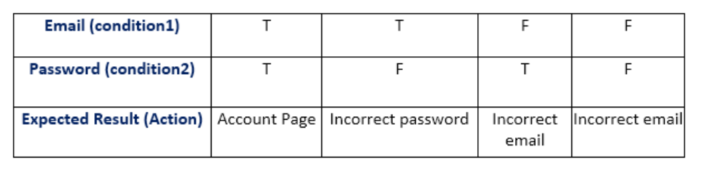
Decision Tables

Slide 39
State Transition Testing
Purpose: Tests the system's behavior in different states and transitions between them.
Approach:
Identify states, inputs, and the transitions between states.
Test how the system moves between states based on events or conditions.
Example: For a vending machine:
States: Idle, Waiting for Payment, Dispensing.
Transitions: Insert Coin → Waiting for Payment; Select Item → Dispensing.
Benefits: Useful for systems with defined workflows or finite state machines.

Slide 40
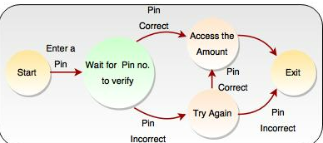
State Transition Testing

Slide 41
Use Case Testing Purpose: Derives test cases from use cases to validate specific user scenarios. Approach: Identify use cases (user interactions with the system). Develop test cases for each use case, including alternative and exception paths. Example: For an online shopping cart Use Case: Add Item to Cart. Test Cases: Add an item, remove an item, try adding an out-of-stock item. Benefits: Focuses on end-user perspective and functional flows.

Slide 42
Dynamic Testing - Structure-Based Testing Techniques
Structure-Based Testing Techniques (also known as White-Box Testing Techniques) are a subset of Dynamic Testing that focus on testing the internal structure and logic of the software.
These techniques require knowledge of the code or architecture and aim to validate the implementation against expected behavior

Slide 43
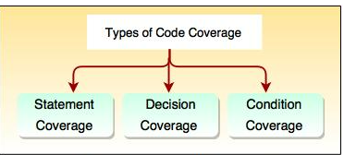
Dynamic Testing - Structure-Based Testing Techniques

Slide 44
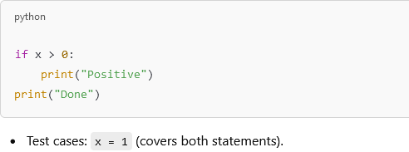
Dynamic Testing - Structure-Based Testing Techniques
Statement Coverage
Purpose: Ensures that every executable statement in the code is executed at
least once during testing.
Approach:
Write test cases to execute all statements in the code.
Example: For the following code:

Slide 45
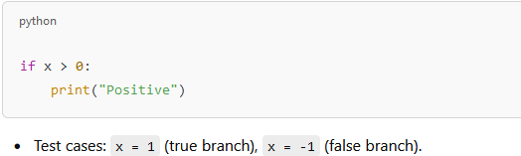
Dynamic Testing - Structure-Based Testing Techniques
Decision Coverage (Branch Coverage)
Purpose: Ensures that every decision in the code (e.g., if, while, for)
evaluates to both true and false at least once.
Approach:
Write test cases to cover all decision outcomes.
Example: For the same code:

Slide 46
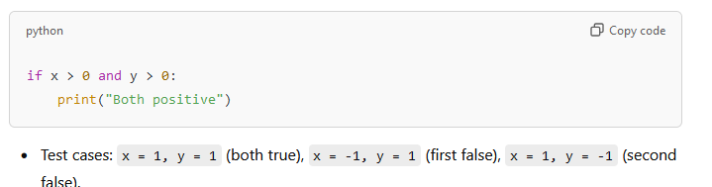
Dynamic Testing - Structure-Based Testing Techniques
Condition Coverage
Purpose: Validates that each condition in a decision evaluates to true and
false at least once.
Approach:
Test each condition within a decision separately.
Example: For the code:

Slide 47
Dynamic Testing - Experience-Based Testing Technique
Experience-Based testing technique requires testers to possess knowledge, skills and background. These are important to test conditions and test cases
The experience people in both technical and business are needed, because they bring various aspects to test, analysis and design process as well as they may have an idea about which is the best way for testing and what is going wrong.
This technique is used with specification-based and structured based techniques and also used when there is no specialization or the specification is out of date.
This technique is used for low-risk system.

Slide 48
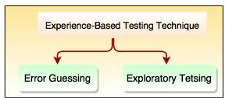
Types of Experience Based Testing Technique i) Error guessing ii) Exploratory testing

Slide 49
Dynamic Testing - Experience-Based Testing Technique – Exploratory testing
Definition: Testing where test design and execution occur simultaneously, guided by the tester's skills, intuition, and knowledge of the system.
Approach:
Define a broad testing goal or charter.
Explore the application to uncover defects and understand its behavior.
Record observations and results.
Example: Navigating an e-commerce website, performing actions like searching for products, adding to the cart, and checking out without predefined test cases.
Benefits:
Flexible and adaptable to changing requirements.
Encourages creativity and discovery of edge cases.
Effective for uncovering unexpected defects.

Slide 50
Dynamic Testing - Experience-Based Testing Technique – Error guessing
Definition: A technique where testers use their experience to guess where defects might occur based on past issues or knowledge of common problem areas.
Approach:
Identify potential weak spots in the application, such as:
Boundary conditions.
Complex functionalities.
Areas with frequent past defects.
Create test cases targeting these areas.
Example: Testing a form submission for special characters, empty fields, or incorrect data types.
Benefits:
Quick and straightforward.
Leverages the tester's expertise for targeted defect detection.

Slide 51
Types of testing White box testing
Definition: White-box testing (also known as Clear Box, Glass Box, or Structural Testing) involves testing the internal logic, structure, and code of the application.
Key Features:
Testers have full knowledge of the code and internal workings of the application.
Focuses on how the software is implemented.
Techniques:
Statement Coverage: Ensures every line of code is executed at least once.
Branch Coverage: Tests all possible outcomes of conditional statements.
Path Coverage: Validates all independent paths through the code.
Unit Testing: Testing individual components in isolation.
Advantages:
Ensures maximum code coverage.
Detects hidden errors like unused code or security vulnerabilities.
Optimizes code quality and reliability
Disadvantages:
Requires programming knowledge.
Time-consuming for large and complex systems.
Example:
Testing a login function by inspecting the code logic, including conditions for valid and invalid credentials.

Slide 52
Types of testing - Black-Box Testing
Definition: Black-box testing involves testing the functionality of the software without any knowledge of its internal code or structure.
Key Features:
Focuses on inputs and expected outputs based on functional requirements.
Does not consider how the functionality is implemented.
Techniques:
Equivalence Partitioning: Dividing input data into valid and invalid partitions.
Boundary Value Analysis: Testing at the edges of input ranges.
Decision Table Testing: Validating combinations of inputs and outputs.
State Transition Testing: Testing state changes in workflows.
Advantages:
Suitable for testers without programming knowledge.
Tests the application from the user’s perspective.
Effective for uncovering functional and usability defects.
Disadvantages:
Limited by lack of insight into the internal structure.
May miss some implementation-level defects.
Example:
Testing a registration form by entering valid and invalid data to ensure proper validation and error messages.

Slide 53
Types of testing – Grey box testing
Definition: Grey-box testing is a hybrid approach that combines aspects of white-box and black-box testing. The tester has partial knowledge of the internal structure but primarily tests from the user’s perspective.
Key Features:
Testers may have access to design documents, APIs, or limited internal code.
Focuses on functional as well as structural testing.
Techniques:
Matrix Testing: Analyzing the relationship between inputs and outputs.
Regression Testing: Ensuring changes do not introduce new defects.
Fault Injection: Testing error-handling capabilities by introducing faults.
Advantages:
Balanced approach that leverages both structural and functional insights.
Helps detect defects in data flow and integration points.
Ideal for testing web applications and APIs.
Disadvantages:
Requires more preparation than black-box testing.
Testers need some technical knowledge.
Example:
Testing a web application with access to its database schema and APIs, ensuring inputs reflect correctly in the database while validating user-facing functionality.

Slide 54
Types of testing - Regression Testing
Purpose: To ensure that recent changes (like bug fixes, feature additions, or updates) do not introduce new defects or break existing functionality.
When Used:
After code changes.
During regular builds in agile or iterative development.
How It’s Done:
Retest the previously executed test cases to verify that existing features work as expected.
Automated regression testing is often used for efficiency.
Example: Adding a new payment method to an e-commerce site. Regression testing ensures that existing payment methods and related workflows still work.
Advantages:
Maintains the stability of the software.
Detects unintended side effects of code changes.

Slide 55
Types of testing - Smoke Testing
Purpose: To verify that the critical functionalities of the application are working. It acts as a build verification test to check if the application is stable enough for further testing.
When Used:
After a new build is deployed.
How It’s Done:
Testers perform a set of high-level tests focusing on key features (e.g., login, core functionality).
Example: For a banking app, smoke tests might include checking if users can log in, view their account balance, and perform a simple transaction.
Advantages:
Quick feedback on the build's stability.
Prevents wasted effort on deeper testing of a broken build.

Slide 56
Types of testing – Sanity testing
Purpose: To validate that specific changes or bug fixes work as expected and haven’t broken related areas. It is narrower in scope than regression or smoke testing.
When Used:
After receiving a new build with minor code changes or bug fixes.
How It’s Done:
Focused testing around the specific change or defect fix.
Typically not scripted, relying on the tester’s understanding of the impact area.
Example: After fixing an issue with the "Add to Cart" button on an e-commerce website, sanity testing would ensure the fix works and related functions like "View Cart" and "Checkout" are not broken.
Advantages:
Quick and efficient validation of targeted areas.
Reduces the scope of testing when time is limited.

Slide 57
Types of testing - User Acceptance Testing (UAT)
Purpose: To validate that the software meets business requirements and is ready for release from the end-user's perspective.
When Used:
Just before the application is deployed to production.
How It’s Done:
Performed by business stakeholders or end-users in a staging or test environment.
Test scenarios focus on real-world workflows and business use cases.
Example: For a new HR management system, UAT would involve HR representatives testing features like employee onboarding, payroll processing, and leave management.
Advantages:
Ensures the software meets user expectations.
Reduces the risk of releasing a product that doesn’t satisfy business needs.

Slide 58
Types of testing – Performance testing
Purpose: To evaluate the speed, responsiveness, and stability of the software under various conditions.
Key Features:
Measures how the system performs under expected workloads.
Focuses on metrics like response time, throughput, and resource usage (CPU, memory, disk, etc.)
When Used:
During system or acceptance testing phases.
Before deployment, especially for high-traffic systems.
Example:
Testing how quickly a web application processes user login requests under normal traffic conditions.
Benefits:
Ensures smooth and efficient user experiences.
Identifies potential performance bottlenecks.

Slide 59
Types of testing – Load Testing
Purpose: To verify that the software performs well under expected user load or traffic.
Key Features:
Simulates real-world usage by increasing the number of concurrent users or transactions.
Identifies the maximum load the system can handle without performance degradation.
When Used:
Before deployment to ensure the system meets performance expectations.
Example:
Testing an e-commerce platform with 1,000 simultaneous users searching, browsing, and checking out.
Benefits:
Ensures the system meets expected performance levels.
Detects performance issues before users encounter them.

Slide 60
Types of testing – Stress Testing
Purpose: To determine how the software behaves under extreme or beyond-normal load conditions.
Key Features:
Pushes the system beyond its breaking point to identify failure modes.
Evaluates how gracefully the system recovers from failure.
When Used:
After load testing, to assess system limits and error-handling capabilities.
Example:
Simulating 10,000 concurrent users logging into a system designed to handle only 1,000 users.
Benefits:
Identifies the breaking point and recovery capabilities.
Ensures system stability under high-stress scenarios.

Slide 61
Types of testing – Usability Testing
Purpose: To evaluate how user-friendly and intuitive the application is for end-users.
Key Features:
Involves real users performing specific tasks.
Focuses on ease of use, user satisfaction, and accessibility.
When Used:
During system or acceptance testing.
Before finalizing the UI/UX design.
Example:
Testing how easily users can navigate a new banking app to check their account balance.
Benefits:
Enhances user satisfaction and adoption.
Identifies design flaws or confusing workflows.

Slide 62
Types of testing – Security Testing
Purpose: To identify vulnerabilities and ensure that the software is secure against threats like unauthorized access, data breaches, and malware.
Key Features:
Focuses on authentication, authorization, encryption, and other security measures.
Includes testing for SQL injection, cross-site scripting (XSS), and other vulnerabilities.
When Used:
During development and before deployment.
Regularly in production to address emerging threats.
Example:
Testing whether a web application is vulnerable to SQL injection by inputting malicious queries in search fields.
Benefits:
Protects sensitive data and prevents financial or reputational loss.
Ensures compliance with security standards and regulations (e.g., GDPR, HIPAA).

Slide 63
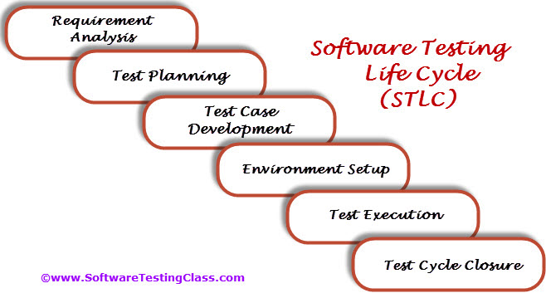
STLC - Software testing life cycle

Slide 64
STLC - Software testing life cycle
Phases of STLC
Requirement Analysis
Objective: Understand the testing requirements and identify the scope of testing.
Activities:
Analyze software requirements and specifications.
Identify types of testing to be performed (functional, performance, security, etc.).
Identify testable and non-testable requirements.
Deliverables:
Requirement Traceability Matrix (RTM).
Test environment requirements.

Slide 65
STLC - Software testing life cycle
2. Test Planning
Objective: Define the test strategy and plan the testing activities.
Activities:
Create the test plan document.
Define testing scope, objectives, and deliverables.
Identify required resources (tools, environments, testers).
Estimate testing effort and timelines.
Deliverables:
Test Plan Document.
Resource and effort estimates.

Slide 66
STLC - Software testing life cycle
3. Test Case Development
Objective: Design detailed test cases based on the requirements.
Activities:
Write test cases and test scripts.
Review and finalize test cases.
Prepare test data for execution.
Deliverables:
Test cases and test scripts.
Test data.

Slide 67
STLC - Software testing life cycle
4. Test Environment Setup
Objective: Prepare the testing environment for executing test cases.
Activities:
Set up hardware and software required for testing.
Install and configure test environment tools.
Validate the test environment with a smoke test.
Deliverables:
Test environment setup and validation results.

Slide 68
STLC - Software testing life cycle
5. Test Execution
Objective: Execute test cases and log defects for failed tests.
Activities:
Execute prepared test cases.
Record actual results and compare them with expected results.
Log defects in a defect-tracking system.
Retest and perform regression testing as needed.
Deliverables:
Test execution reports.
Defect reports.

Slide 69
STLC - Software testing life cycle
6. Test Closure
Objective: Conclude testing activities and provide test results to stakeholders.
Activities:
Evaluate test coverage and test objectives.
Document lessons learned and best practices.
Archive test cases, scripts, and related documents.
Deliverables:
Test Summary Report.
Test metrics and closure documentation.

Slide 70
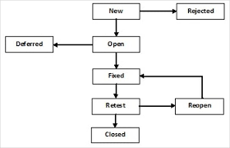
Defect Life cycle Management

Slide 71
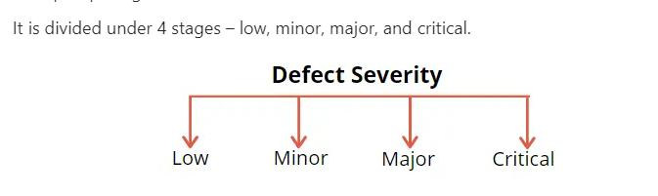
Defect Life Cycle Process
Severity means – “The degree of impact that a defect has on the development or operation of a component or system.”

Slide 72
Defect Life Cycle Process
Severity |  | It is specified by the tester how much effect it gives to the application
Critical |  | Tester will give this status when u r not able to continue your testing eg. Not opening application
High |  | Tester will give this status if he is not able to test this Module but he can test some other module
Medium |  | Tester will give the status if he is not able to progress in the current module
Low |  | Its like cosmetic some spell mistake or look and feel problem

Slide 73
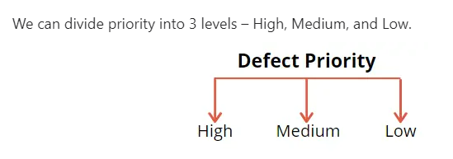
Defect Life Cycle Process
Priority means – “The level of (business) importance assigned to an item, e.g., defect”.

Slide 74
Defect Life Cycle Process
Bug Priority Levels
HIGH – Such defect needs immediate attention as it might lead to complete failure of the system. The earliest resolution of such defects should be conducted. Delay in finding the solution might affect the system adversely. Often leading to even more complications
MEDIUM – Such bugs do not affect the working of the system. These can be solved simultaneously with the testing as well as the design phase. These bugs do need to be fixed but do not need any immediate attention.
LOW – These bugs are at the lowest priority. These are fixed once the developer is done with the high and medium-priority bugs.

Slide 75
Thank You

